Slide 1
Parameter recovery

Slide 2
Model recovery

Slide 3
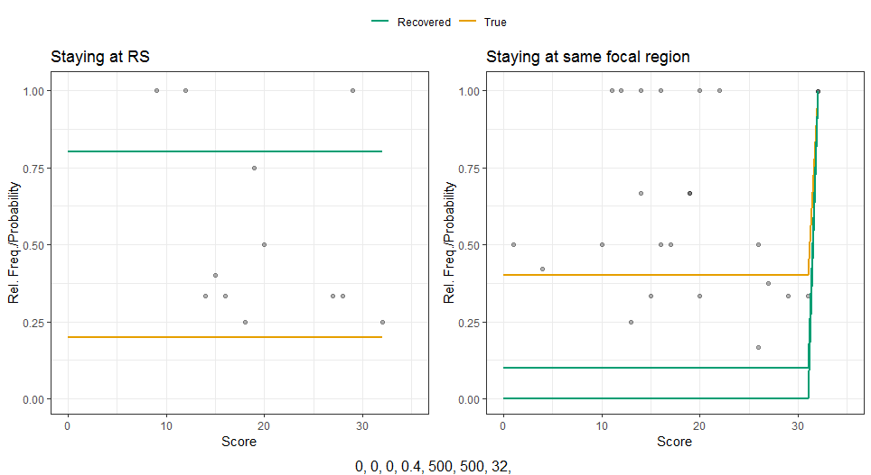
2 focal regions – high

Slide 4
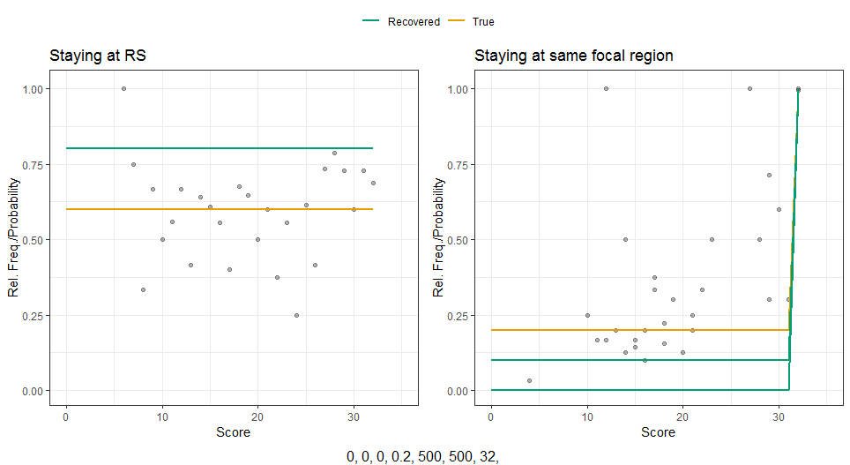
2 focal regions – medium

Slide 5
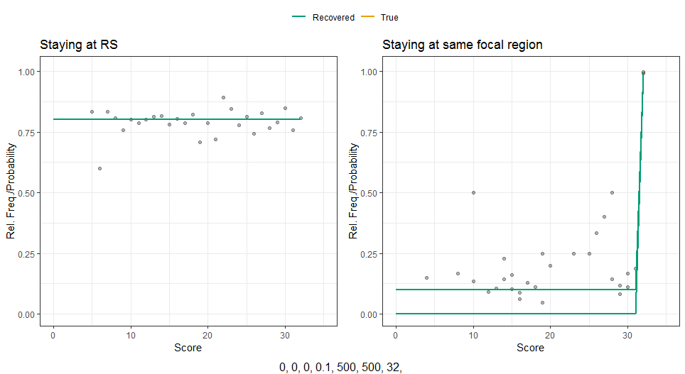
2 focal regions – low

Slide 6
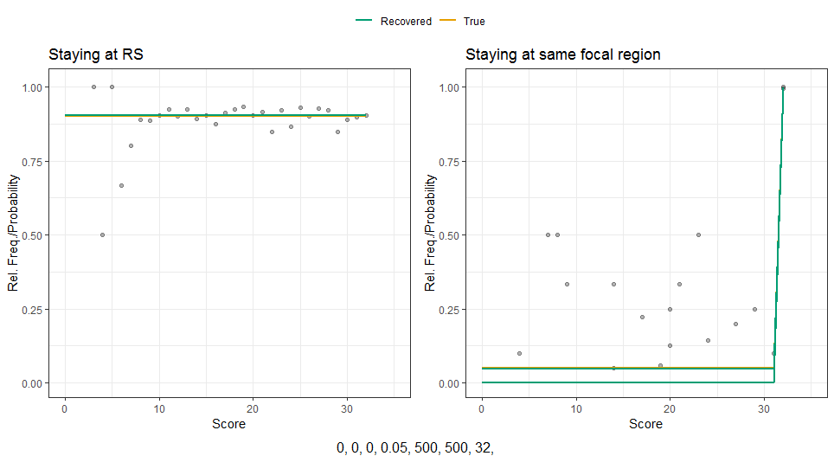
2 focal regions – too low

Slide 7
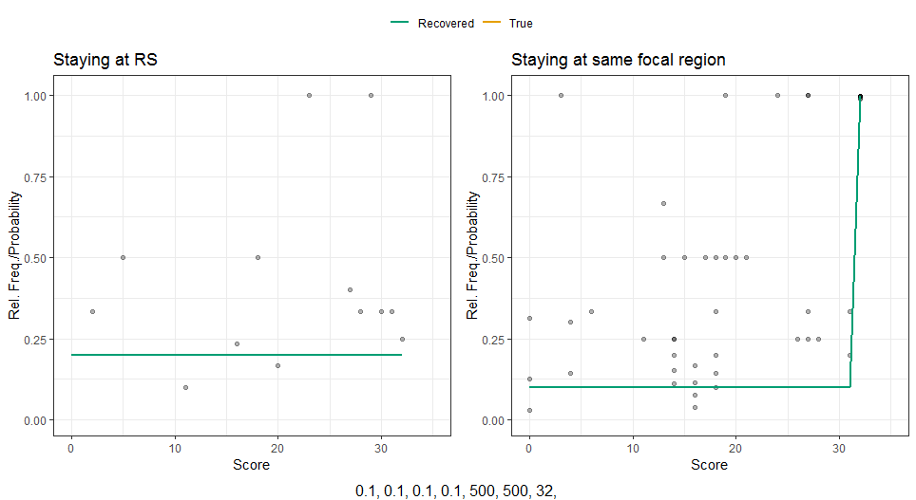
8 focal regions – high

Slide 8
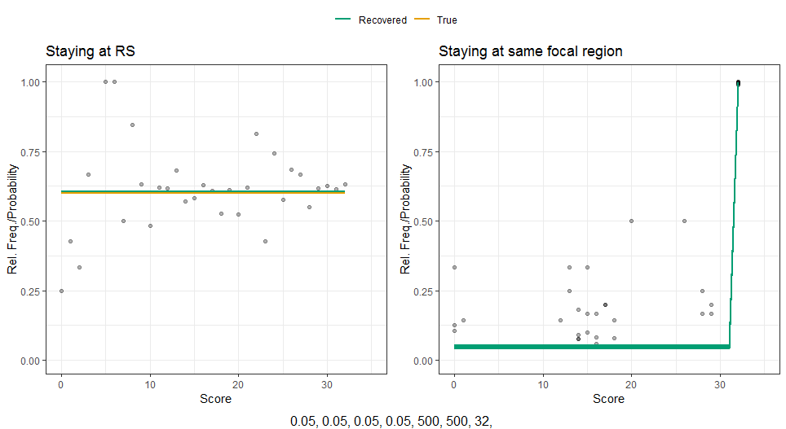
8 focal regions – medium

Slide 9
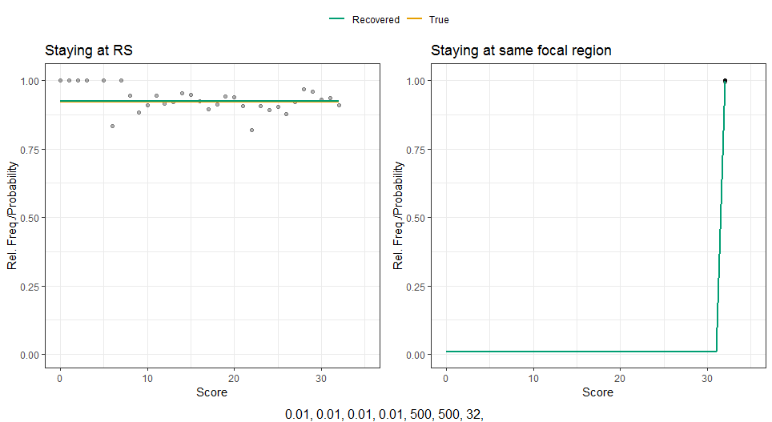
8 focal regions – low

